Slide 1
Azure Kubernetes services
Anju munoth

Slide 2
Container
An atomic unit of software that packages up code, dependencies, and configuration for a specific application.
Allows to split up monolithic applications into individual services that make up the solution.
Enables to deploy these separate services via containers.

Slide 3
Why use a container?
Suppose your asset-tracking solution included three major applications:
A tracking website that includes maps and information about the assets being tracked
A data processing service that collects and processes information sent from tracked assets
An MSSQL database for storing customer information captured from the website
To meet customer demand --have to scale out solution.

Slide 4
Virtual Machines (VMs)
One option is to deploy a new virtual machine for every application, hosted across multiple regions.
Then, copy the applications to your new VMs.
Doing so makes you responsible for managing each VM that you use.
Maintenance overhead increases as you scale.
Need to provision and configure VM operating system (OS) versions and dependencies for each application to match.
When you apply upgrades for your applications that affect the OS and major changes, there are precautions.
If any errors appear during the upgrade, you need to roll back the installation, which causes disruption such as downtime or delays.
Deployment is cumbersome, sometimes error-prone, and doesn't easily scale single services. For example, you can't easily scale only the caching service used in the web application.

Slide 5
Why container?
Immutability: Unchanging nature of a container allows it to deploy and run reliably with the same behavior from one compute environment to another.
A container image tested in a QA environment is the same container image deployed to production.
Smaller Size: A container is similar to a VM, but without the kernel for each machine.
Instead, they share a host kernel. VMs use a large image file to store both the OS and the application you want to run.
In contrast, a container doesn't need an OS, only the application.
Lightweight: Container always relies on the host-installed OS for kernel-specific services.
Lightweight property makes containers less resource-intensive, so installing multiple containers is possible within the same compute environment.
Startup is fast: Containers start up in few seconds, unlike VMs, which can take minutes to start.

Slide 6
What is container management?
Container has a distinct lifecycle that exists as a temporary machine.
State passes through the stages of pending, running, and terminated.
Lifecycle makes containers more disposable and affects how developers and IT operations think about the management of large interconnected applications.
Container management involves deploying, upgrading, monitoring, and removing containers.
For example, suppose that you discover that at noon there's more site traffic, so you need more instances of the site's caching service to manage performance. You plan to solve this problem by adding more caching service containers.
Now it's time to roll out a new version of your caching service. How do you update all the containers? How do you remove all the older versions?
These types of load-balancing questions require a system to manage your container deployment.

Slide 7
What is Kubernetes?
Kubernetes is a portable, extensible, open-source platform that automates deploying, scaling, and managing containerized workloads.
Kubernetes abstracts away complex container management and provides us with a declarative configuration to orchestrate containers in different compute environments.
This orchestration platform gives us the same ease of use and flexibility as with Platform as a Service (PaaS) and Infrastructure as a Service (IaaS) offerings.

Slide 8
What is Kubernetes?
Kubernetes isn't a full PaaS offering.
Operates at the container level and offers only a common set of PaaS features.
Kubernetes isn't monolithic. It's not a single application that's installed. Aspects such as deployment, scaling, load balancing, logging, and monitoring are all optional.
Kubernetes doesn't limit the types of applications you can run. If your application can run in a container, it runs on Kubernetes.
Kubernetes doesn't provide middleware, data-processing frameworks, databases, caches, or cluster-storage systems. All these items are run as containers or as part of another service offering.
A Kubernetes deployment is configured as a cluster.
A cluster consists of at least one primary machine or control plane and one or more worker machines. For production deployments, the preferred configuration is a high availability deployment with three to five replicated control-plane machines that are referred to as nodes or agent nodes.

Slide 9
Azure Kubernetes Service (AKS)?
AKS manages hosted Kubernetes environment and makes it simple to deploy and manage containerized applications in Azure.
AKS environment is enabled with features such as automated updates, self-healing, and easy scaling.
Azure manages your Kubernetes cluster's control plane for free. You manage the agent nodes in the cluster and only pay for the VMs on which your nodes run.
Can create and manage your cluster in the Azure portal or with the Azure CLI.
When you create the cluster, there are Resource Manager templates to automate cluster creation.
With these templates, you have access to features such as advanced networking options, Microsoft Entra Identity, and resource monitoring.
Can set up triggers and events to automate the cluster deployment for multiple scenarios.
With AKS--get the benefits of open-source Kubernetes without the added complexity or operational overhead that using only Kubernetes can entail.

Slide 10
Service | Consideration
Identity and security management | Do you already use existing Azure resources and make use of Microsoft Entra ID? You can configure an AKS cluster to integrate with Microsoft Entra ID and reuse existing identities and group membership.
Integrated logging and monitoring | AKS includes Azure Monitor for containers to provide performance visibility into the cluster. With a custom Kubernetes installation, you decide on a monitoring solution that requires installation and configuration.
Auto Cluster node and pod scaling | Deciding when to scale up or down in a large containerization environment is tricky. AKS supports two auto cluster scaling options. You can use either the horizontal pod autoscaler or the cluster autoscaler to scale the cluster. The horizontal pod autoscaler watches the resource demand of pods and increases pod resources to match demand. The cluster autoscaler component watches for pods that can't be scheduled because of node constraints. It automatically scales cluster nodes to deploy scheduled pods.
Cluster node upgrades | Do you want to reduce the number of cluster-management tasks? AKS manages Kubernetes software upgrades and the process of cordoning off nodes and draining them to minimize disruption to running applications. Once done, these nodes are upgraded one at a time.

Slide 11
Service | Consideration
GPU enabled nodes | Do you have compute-intensive or graphic-intensive workloads? AKS supports GPU-enabled node pools.
Storage volume support | Is your application stateful, and does it require persisted storage? AKS supports both static and dynamic storage volumes. Pods can attach and reattach to these storage volumes as they're created or rescheduled on different nodes.
Virtual network support | Do you need pod-to-pod network communication or access to on-premises networks from your AKS cluster? An AKS cluster can be deployed into an existing virtual network with ease.
Ingress with HTTP application-routing support | Do you need to make your deployed applications publicly available? The HTTP application-routing add-on makes it easy to access AKS cluster deployed applications.
Docker image support | Do you already use Docker images for your containers? AKS supports the Docker file image format by default.
Private container registry | Do you need a private container registry? AKS integrates with Azure Container Registry (ACR). You aren't limited to ACR; you can use other container repositories, whether public or private.

Slide 12
Cluster components
An AKS cluster is divided into two main components:
Control plane: The control plane provides the core Kubernetes services and orchestration of application workloads.
Nodes: Nodes are the underlying virtual machines (VMs) that run your applications.

Slide 13
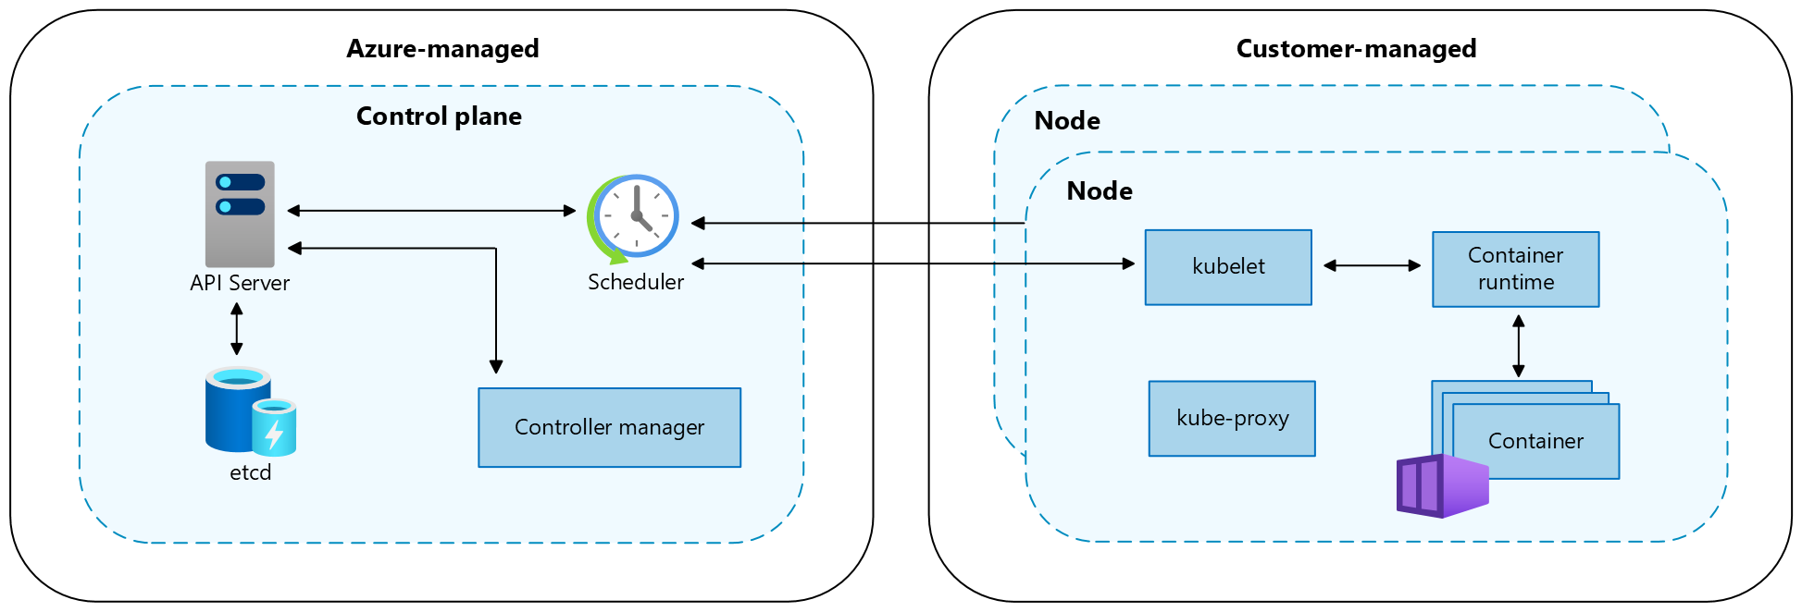
Cluster components

Slide 14
Control plane
Component | Description
kube-apiserver | The API server (kube-apiserver) exposes the Kubernetes API to enable requests to the cluster from inside and outside of the cluster.
etcd | The highly available key-value store etcd helps to maintain the state of your Kubernetes cluster and configuration.
kube-scheduler | The scheduler (kube-scheduler) helps to make scheduling decisions. It watches for new pods with no assigned node and selects a node for them to run on.
kube-controller-manager | The controller manager (kube-controller-manager) runs controller processes, such as noticing and responding when nodes go down.
cloud-controller-manager | The cloud controller manager (cloud-controller-manager) embeds cloud-specific control logic to run controllers specific to the cloud provider.

Slide 15
Nodes
Clusters are a group of computers that work together and share resources to help improve performance and availability.
If any computers in the cluster fail, the services running on the cluster can continue running on the remaining functioning computers.
In Microsoft Azure, those computers are known as virtual machines (VMs). In Kubernetes, those VMs are known as nodes.
Nodes need network connectivity so they can communicate with one another and effectively route network traffic.
Nodes also need to communicate with the Kubernetes control plane, which provides the core Kubernetes services and orchestration of application workloads, so they can run your application workload resources.

Slide 16
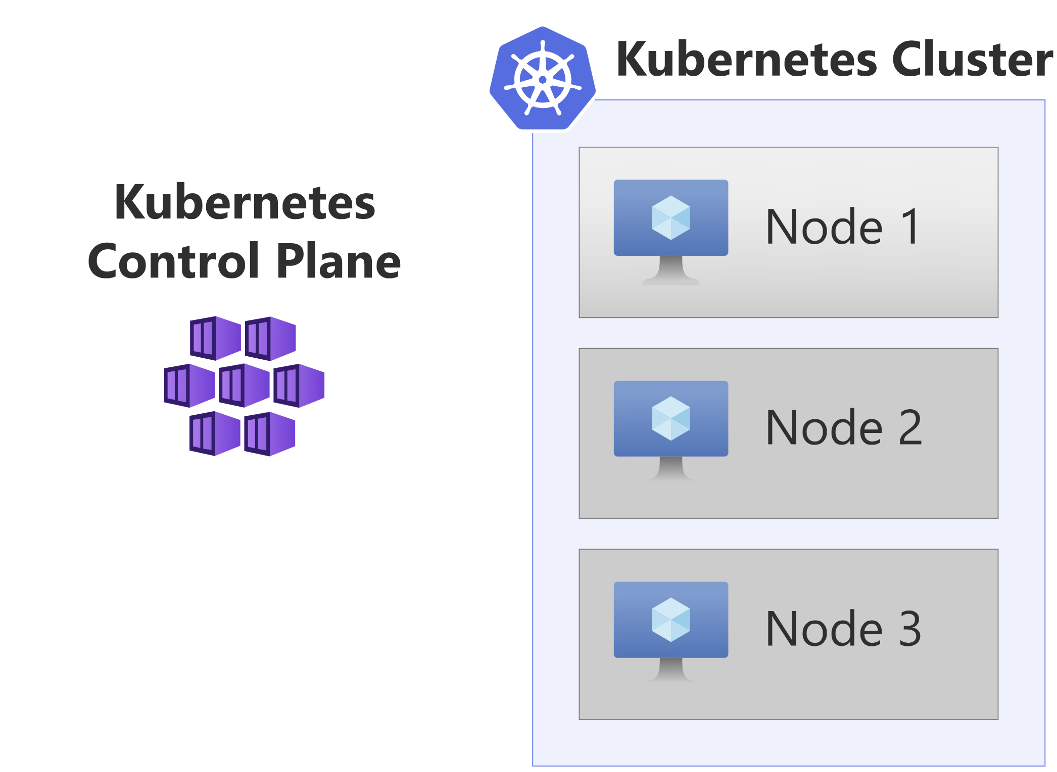

Slide 17
Nodes
Each AKS cluster has at least one node, which is an Azure VM that runs Kubernetes node components
Component | Description
kubelet | kubelet ensures that containers are running in a pod.
kube-proxy | kube-proxy is a network proxy that maintains network rules on nodes.
container runtime | container runtime manages the execution and lifecycle of containers.

Slide 18
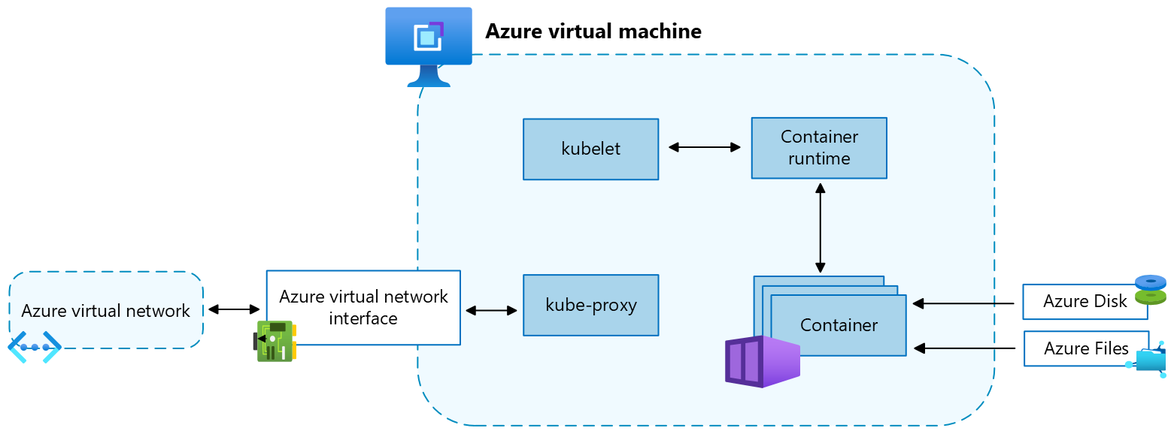
Nodes

Slide 19
Node configuration
VM size and image
The Azure VM size for your nodes defines CPUs, memory, size, and the storage type available, such as a high-performance solid-state drive or a regular hard-disk drive.
VM size you choose depends on the workload requirements and the number of pods that you plan to run on each node.
As of May 2025, the default VM SKU and size will be dynamically selected by AKS based on available capacity and quota if the parameter is left blank during deployment.
In AKS, the VM image for your cluster's nodes is based on Ubuntu Linux, Azure Linux, or Windows Server 2022.
When you create an AKS cluster or scale out the number of nodes, the Azure platform automatically creates and configures the requested number of VMs.
Agent nodes are billed as standard VMs.
Any VM size discounts, including Azure reservations, are automatically applied.

Slide 20
Node configuration
OS disks
Default OS disk sizing is used on new clusters or node pools only when a default OS disk size isn't specified. This behavior applies to both managed and ephemeral OS disks.
Resource reservations
AKS uses node resources to help the nodes function as part of the cluster. T
his usage can cause a discrepancy between the node's total resources and the allocatable resources in AKS.
To maintain node performance and functionality, AKS reserves two types of resources, CPU and memory, on each node.

Slide 21
Node configuration
OS
AKS supports Ubuntu 22.04 and Azure Linux 2.0 as the node OS for Linux node pools.
For Windows node pools, AKS supports Windows Server 2022 as the default OS.
Windows Server 2019 is being retired after Kubernetes version 1.32 reaches end of life and isn't supported in future releases.
Pods
A pod is a group of one or more containers that share the same network and storage resources and a specification for how to run the containers.
Pods typically have a 1:1 mapping with a container, but you can run multiple containers in a pod.

Slide 22
Node configuration
Container runtime
A container runtime is software that executes containers and manages container images on a node.
Runtime helps abstract away system calls or OS-specific functionality to run containers on Linux or Windows.
For Linux node pools, containerd is used on Kubernetes version 1.19 and higher.
For Windows Server 2019 and 2022 node pools, containerd is generally available and is the only runtime option on Kubernetes version 1.23 and higher.

Slide 23
Node configuration
Node pools
In AKS, nodes of the same configuration are grouped together into node pools.
These node pools contain the underlying virtual machine scale sets and virtual machines (VMs) that run your applications.
When you create an AKS cluster, you define the initial number of nodes and their size (version), which creates a system node pool.
System node pools serve the primary purpose of hosting critical system pods, such as CoreDNS and konnectivity.
To support applications that have different compute or storage demands, you can create user node pools.
User node pools serve the primary purpose of hosting your application pods.

Slide 24
Node configuration
Node pools
Node pools are created as virtual machine scale sets in your Azure subscription.
When you create an AKS cluster, one system node pool is required and is created automatically.
It hosts critical system pods such as CoreDNS and metrics-server.
Can add more user node pools to your AKS cluster to host your applications.

Slide 25
Node configuration
Node resource group
When you create an AKS cluster in an Azure resource group, the AKS resource provider automatically creates a second resource group called the node resource group.
This resource group contains all the infrastructure resources associated with the cluster, including VMs, virtual machine scale sets, and storage.

Slide 26
Node configuration
Namespaces
Kubernetes resources, such as pods and deployments, are logically grouped into namespaces to divide an AKS cluster and create, view, or manage access to resources.
following namespaces are created by default in an AKS cluster:
Namespace | Description
default | default namespace allows you to start using cluster resources without creating a new namespace.
kube-node-lease | kube-node-lease namespace enables nodes to communicate their availability to the control plane.
kube-public | kube-public namespace isn't typically used, but you can use it so that resources are visible across the whole cluster by any user.
kube-system | kube-system namespace is used by Kubernetes to manage cluster resources, such as coredns, konnectivity-agent, and metrics-server.

Slide 27
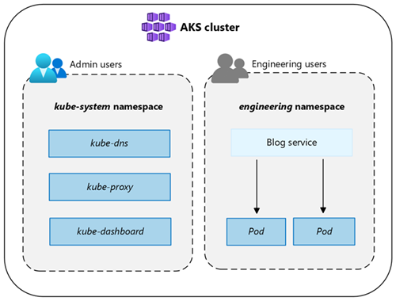
Node configuration

Slide 28
Cluster modes
In AKS, can create a cluster with the Automatic (preview) or Standard mode.
AKS Automatic provides a more fully managed experience.
Can manage cluster configuration, including nodes, scaling, security, and other preconfigured settings.
AKS Standard provides more control over the cluster configuration, including the ability to manage node pools, scaling, and other settings.

Slide 29
Pods
In Kubernetes, application workload resources include pods, deployments, and sets.
Pods are the smallest deployable unit in a Kubernetes cluster.
Distributed across nodes in a way that enables the best use of the available processor and memory resources on the nodes.
Pods typically represent a single instance or subcomponent of application.
Pod might run a shopping cart component that manages the items in a customer's cart or a shipping component that handles the processing of completed orders.
Can run multiple copies, or replicas, of the same pod.
Replicas distribute multiple pods across nodes to provide high availability.
With multiple replicas of the pods, application can continue to work if a component running in a pod fails.

Slide 30
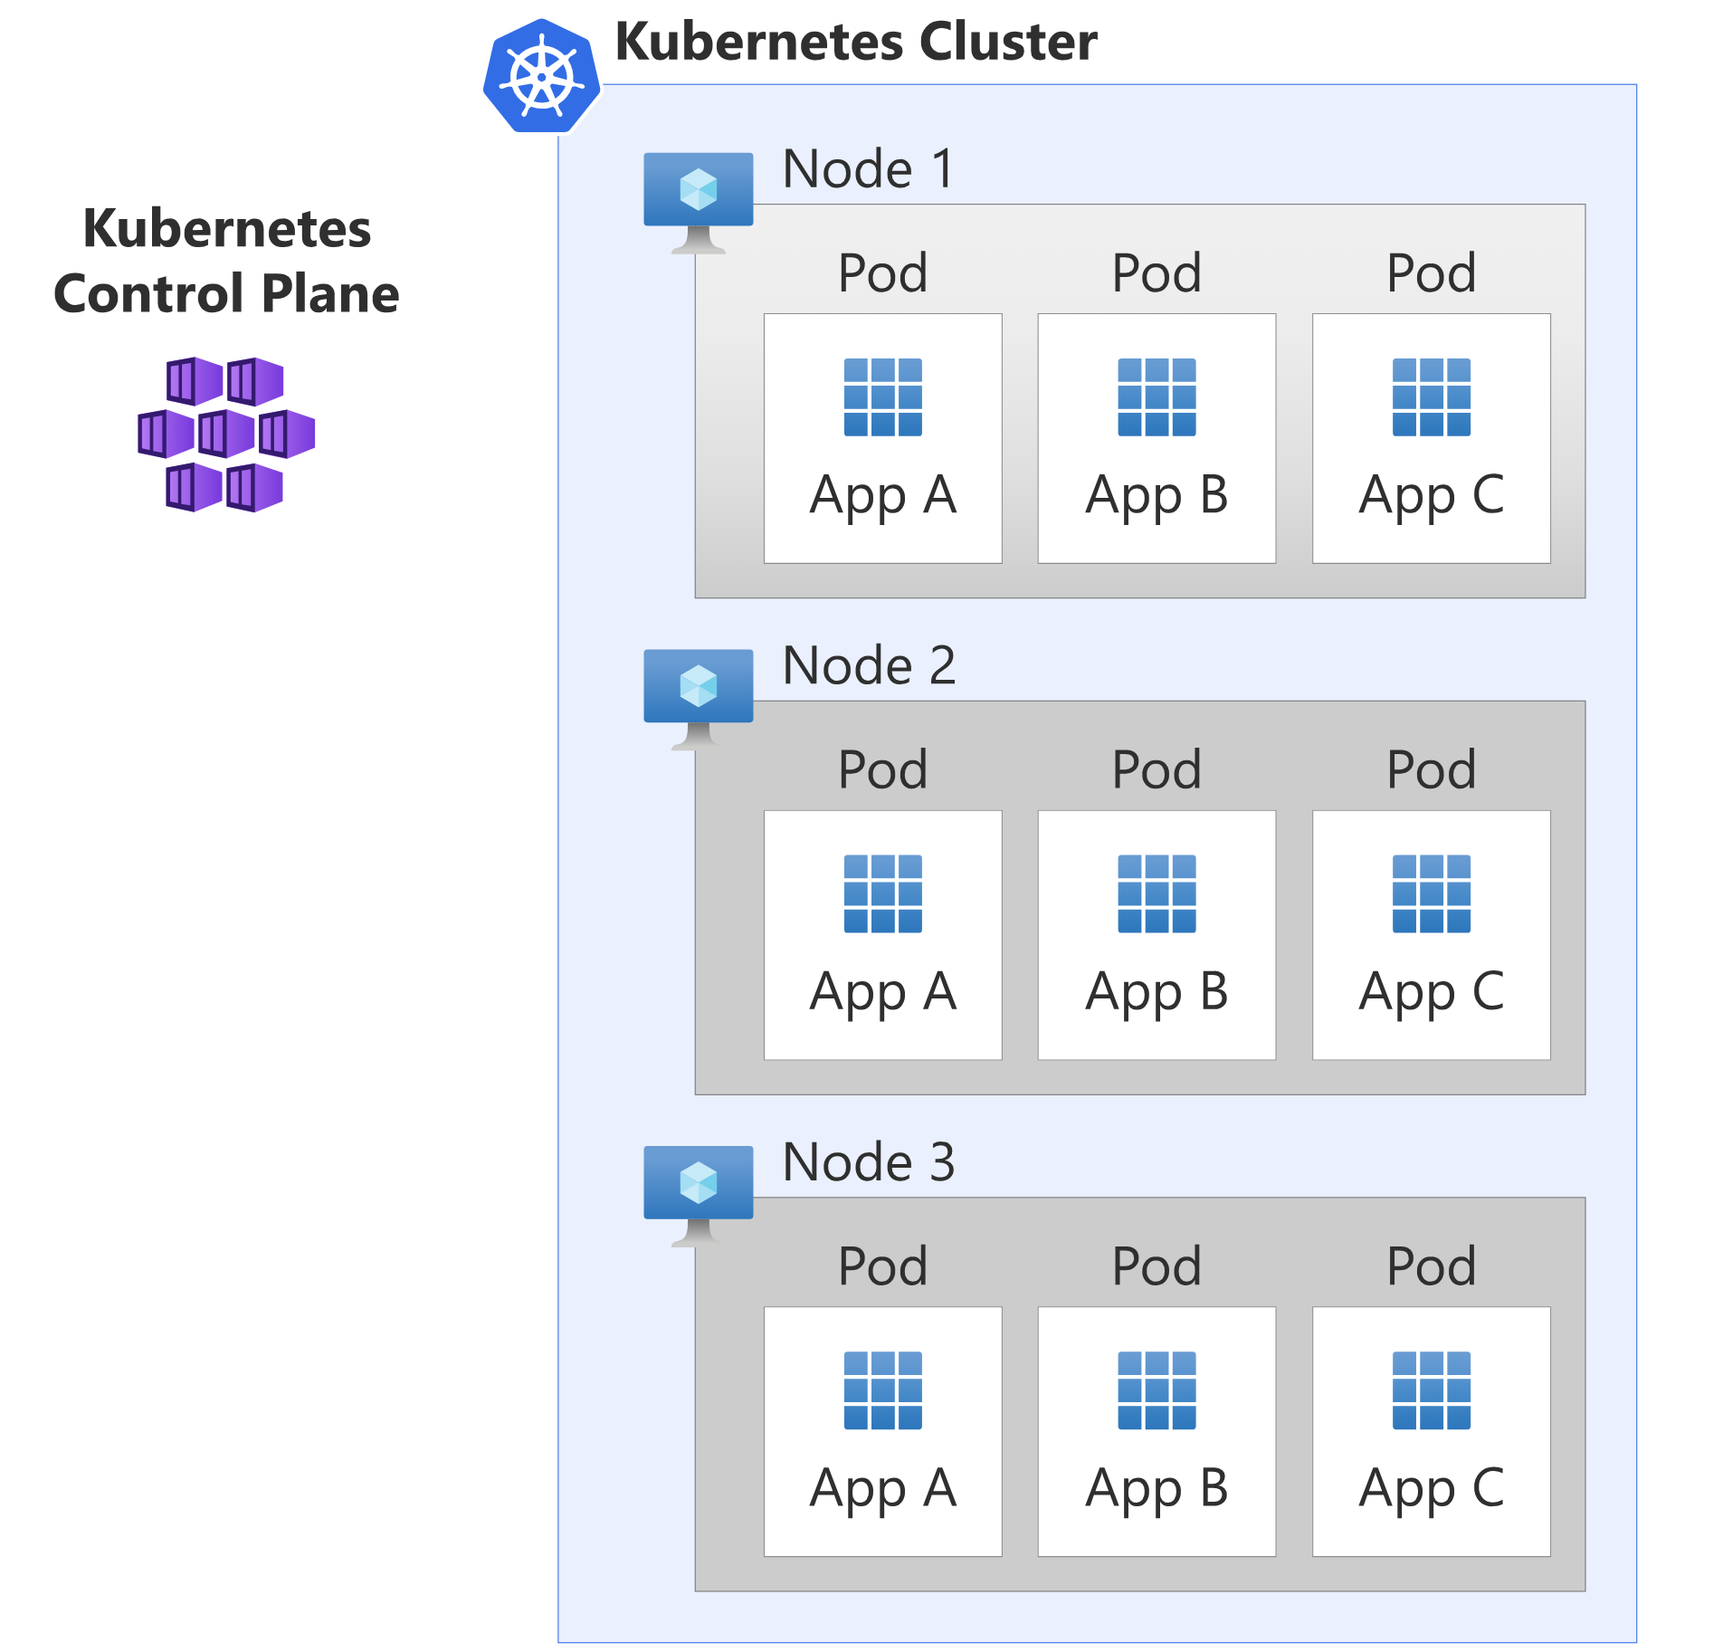

Slide 31
Pods
Can add or remove pods in response to the level of demand on the cluster.
Self-healing abilities in Kubernetes can replace any pod that fails, and the built-in support for rolling updates automates the deployment of new versions of an application without any downtime.
Pods are assigned a new IP address during their initial deployment.
This IP address is used for all network communication with the pod.
Many scenarios where a pod is assigned a new IP address.
When cluster demand is high and scaling occurs, new pods are deployed.
When you update an application, new pods are deployed to replace the old pods.
If a pod fails, a new pod automatically replaces it.
If pod IP addresses experience frequent changes, how does Kubernetes know where to send network traffic to reach our application? The answer is services.

Slide 32
Services
A Kubernetes service sits in front of a group of pods and provides a static IP address.
When traffic arrives at a service, the service distributes it in a round-robin manner to a set of backend pods.
Service tracks changes in the IP addresses of the pods to ensure network traffic is sent to the correct pods.

Slide 33
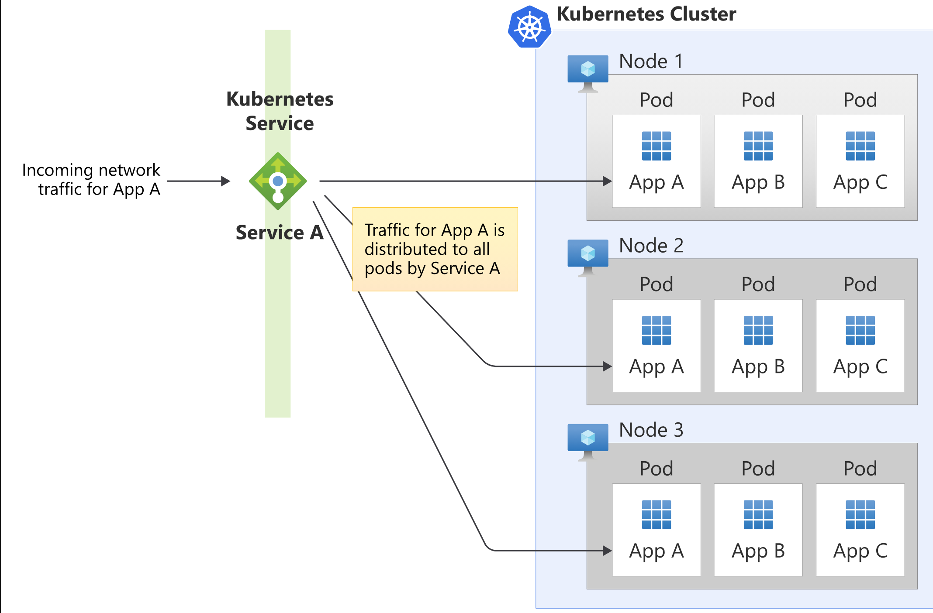

Slide 34
Estimating cluster size - Pods
Nodes, pods, and services need IP addresses.
But, how do you determine how many IP addresses you need?
To determine the number of addresses, you must understand the characteristics of the application.
First, you determine how many pods you need.
Then, you can look at what size nodes are required and how many nodes you need to run.

Slide 35
How many pods do you need?
Your application runs in a pod.
A simple application might run entirely in a single pod.
A more complex application, such as a microservices architecture application consisting of multiple separate services, might have each service running in its own pod, with the pods distributed across multiple nodes.
Need to fully understand the architecture of your application.
From there, you can work out how many pods the application requires.
Can then review how many replicas of each pod you want to run.
You might know your application has fairly predictable usage patterns, and through testing, you determine it runs best with a fixed number of pods.
Or, your application might experience periods of higher or lower demand that requires the number of pods to change in response to the fluctuating traffic.
Even in scenarios with unpredictable usage patterns, you should still set limits on the maximum number of pods that your application can scale up to. This limit ensures that your application doesn't consume all the resources in your cluster.

Slide 36
Estimating cluster size - Nodes
In Azure Kubernetes Service (AKS), each node in your cluster is an Azure VM.
VMs come in various specifications to help support the demands of different types of applications.
Some applications might need more processing power or memory, or faster storage.
Need to select a VM category and instance that meets the needs of application.
Want to make sure the type has enough memory and processing power for your application.
Keep in mind that not all of the memory and processing power is available for your application.
Some of this power is needed for the operating system and for Kubernetes system components. AKS automatically reserves a certain amount of memory and processing power to ensure these critical system components can operate as needed.
Default VM type deployed as part of an AKS cluster is the D2 v3 general purpose virtual machine, a two core VM with 8 gigabytes of memory. AKS reserves 100 millicores of processor and 3.55 GiB of memory, leaving 1,900 millicores (1.9 cores) and 5.45Gi of memory free for your application.

Slide 37
stranded resources
Imagine that you deploy three applications to a D2 v3 node.
Each of those applications requires 600 millicores of processor and 500Mi of memory.
Once you deploy those applications, 100 millicores of processor remains, and there's about 2.05 GiB of unused memory.
If you deployed a fourth instance of the application, you would need to send it to a new node because the remaining 100 millicores aren't sufficient.
However, that leaves 2 GiB of memory on the node that can't be used. That memory resource is referred to as stranded.
An ideal VM choice is one with enough capacity to run your workloads without leaving resources stranded.
If workloads scale up and down dynamically, you want enough resources to cover typical usage scenarios, but the flexibility to scale up when needed.

Slide 38
How many nodes do you need?
Application should always be available and able to handle failure of the underlying nodes.
Can provide resilience with multiple replicas of the application spread across multiple nodes.
AKS has node pools, which are groups of VMs of the same type.
Can have multiple node pools.
For example, you could have a node pool that contains general purpose VMs, a node pool with memory-optimized VMs, and a node pool with GPU-equipped VMs.
Can then use the native Kubernetes scheduling feature to ensure your workloads are deployed to the appropriate node pool and VM type.
Node pools can support one of two modes: System or User.
System node pools run critical system pods that are essential to the operation of your Kubernetes cluster, including services such as storage drivers, DNS, or metrics servers.
User node pools run your applications.

Slide 39
How many nodes do you need?
In a default configuration, an AKS cluster contains a single System node pool, which is used to run everything.
If you want, you can add extra System or User node pools and configure your application pods to run exclusively in the User node pools.
Critical system pods run only in the System node pools.
Using System and User node pools can prevent incorrectly configured applications from affecting the operation of critical system services and potentially causing the cluster to fail.
Kubernetes can also add or remove nodes when necessary.
Need to define an upper limit for the maximum number of nodes that Kubernetes can scale up to.
Then, plan your network design around that maximum number.
Keep in mind that you need to account for at least one extra node per cluster to allow for the update process to run properly.

Slide 40
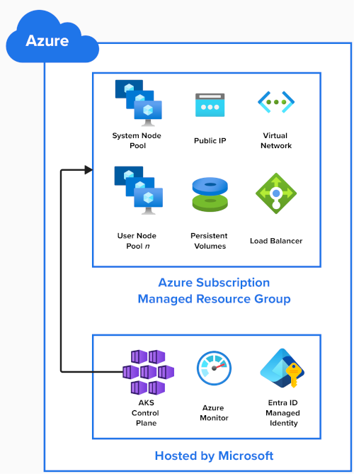
AKS resources

Slide 41
Load balancers
Kubernetes deploys Azure Standard Load Balancer by default, which balances inbound traffic across all zones in a region. If a node becomes unavailable, the load balancer reroutes traffic to healthy nodes.
An example service that uses Azure Load Balancer:
apiVersion: v1
kind: Service
metadata:
name: example
spec:
type: LoadBalancer
selector:
app: myapp
ports:
- port: 80
targetPort: 8080

Slide 42
Reliability architecture overview
When you create an AKS cluster, the Azure platform automatically creates and configures:
A control plane that has the API server, etcd, the scheduler, and other pods that are required to manage your workload.
A system node pool to your subscription that hosts your add-ons and other pods that run in the kube-system namespace.
After this initial node pool setup is complete, you can add or delete node pools for your own user workloads.
AKS doesn't manage node pools for reliability, and you must ensure that your workloads are resilient to infrastructure failures.

Slide 43
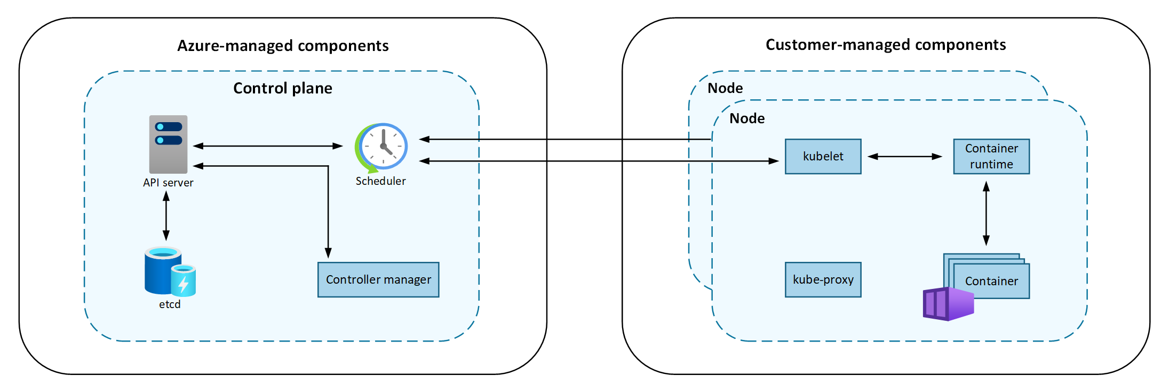
Reliability architecture overview

Slide 44
Resiliency
Resiliency is a shared responsibility between you and Microsoft.
As a compute service, AKS manages some aspects of your cluster's reliability, but you're responsible for managing other aspects.
Microsoft manages the control plane and other managed components of AKS.
It's your responsibility to:
Define how components, including node pools and load balancers that attach to services, should be configured to meet your reliability requirements.
After you define the components, Microsoft then deploys and manages them on your behalf.
Manage any components outside of the AKS cluster, including storage and databases.
Verify that these components meet your reliability requirements.
When you deploy your workloads, ensure that other Azure components are also configured for resiliency by following the best practices for those services.

Slide 45
Networking in AKS
In a container-based, microservices approach to application development, application components work together to process their tasks.
Kubernetes provides various resources enabling this cooperation:
Can connect to and expose applications internally or externally.
Can build highly available applications by load balancing your applications.
Can restrict the flow of network traffic into or between pods and nodes to improve security.
Can configure Ingress traffic for SSL/TLS termination or routing of multiple components for your more complex applications.

Slide 46
Kubernetes networking
Kubernetes employs a virtual networking layer to manage access within and between your applications or their components:
Kubernetes nodes and virtual network: Kubernetes nodes are connected to a virtual network. This setup enables pods (basic units of deployment in Kubernetes) to have both inbound and outbound connectivity.
Kube-proxy component: kube-proxy runs on each node and is responsible for providing the necessary network features.

Slide 47
Networking in AKS
Regarding specific Kubernetes functionalities:
Load balancer: You can use a load balancer to distribute network traffic evenly across various resources.
Ingress controllers: These facilitate Layer 7 routing, which is essential for directing application traffic.
Egress traffic control: Kubernetes allows you to manage and control outbound traffic from cluster nodes.
Network policies: These policies enable security measures and filtering for network traffic in pods.

Slide 48
Networking in AKS
Azure streamlines virtual networking for AKS (Azure Kubernetes Service) clusters.
Creating a Kubernetes load balancer on Azure simultaneously sets up the corresponding Azure load balancer resource.
As you open network ports to pods, Azure automatically configures the necessary network security group rules.
Azure can also manage external DNS configurations for HTTP application routing as new Ingress routes are established.

Slide 49
Azure virtual networks
In AKS, you can deploy a cluster that uses one of the following network models:
Overlay network model: Overlay networking is the most common networking model used in Kubernetes.
Pods are given an IP address from a private, logically separate CIDR from the Azure virtual network subnet where AKS nodes are deployed.
This model enables simpler, improved scalability when compared to the flat network model.
Flat network model: A flat network model in AKS assigns IP addresses to pods from a subnet from the same Azure virtual network as the AKS nodes.
Any traffic leaving your clusters isn't SNAT'd, and the pod IP address is directly exposed to the destination.
This model can be useful for scenarios like exposing pod IP addresses to external services.

Slide 50
Control outbound (egress) traffic
AKS clusters are deployed on a virtual network and have outbound dependencies on services outside of that virtual network, which are almost entirely defined with fully qualified domain names (FQDNs).
AKS provides several outbound configuration options which allow you to customize the way in which these external resources are accessed.
By default, AKS clusters have unrestricted outbound (egress) Internet access, which allows the nodes and services you run to access external resources as needed.
If desired, you can restrict outbound traffic.

Slide 51
Scaling in AKS
When running applications in Azure Kubernetes Service (AKS), you may need to increase or decrease the amount of compute resources.
As you change the number of application instances you have, you may need to change the number of underlying Kubernetes nodes.
Also may need to provision a large number of other application instances.

Slide 52
Manually scale pods or nodes
Can manually scale replicas, or pods, and nodes to test how your application responds to a change in available resources and state.
Manually scaling resources lets you define a set amount of resources to use to maintain a fixed cost, such as the number of nodes.
To manually scale, you define the replica or node count.
The Kubernetes API then schedules creating more pods or the draining of nodes based on that replica or node count.
When scaling down nodes, the Kubernetes API calls the relevant Azure Compute API tied to the compute type used by your cluster.
For example, for clusters built on Virtual Machine Scale Sets, Virtual Machine Scale Sets API determines which nodes to remove.

Slide 53
Horizontal pod autoscaler
Kubernetes uses the horizontal pod autoscaler (HPA) to monitor the resource demand and automatically scale the number of pods.
By default, the HPA checks the Metrics API every 15 seconds for any required changes in replica count, and the Metrics API retrieves data from the Kubelet every 60 seconds.
So, the HPA is updated every 60 seconds.
When changes are required, the number of replicas is increased or decreased accordingly. HPA works with AKS clusters that deployed the Metrics Server for Kubernetes version 1.8 and higher.
When you configure the HPA for a given deployment, you define the minimum and maximum number of replicas that can run.
Also define the metric to monitor and base any scaling decisions on, such as CPU usage.

Slide 54
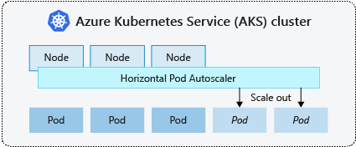
Horizontal pod autoscaler

Slide 55
Horizontal pod autoscaler
Cooldown of scaling events
As the HPA is effectively updated every 60 seconds, previous scale events may not have successfully completed before another check is made.
This behavior could cause the HPA to change the number of replicas before the previous scale event could receive application workload and the resource demands to adjust accordingly.
To minimize race events, a delay value is set.
This value defines how long the HPA must wait after a scale event before another scale event can be triggered.
This behavior allows the new replica count to take effect and the Metrics API to reflect the distributed workload.
There's no delay for scale-up events as of Kubernetes 1.12, however, the default delay on scale down events is 5 minutes.

Slide 56
Cluster autoscaler
To respond to changing pod demands, the Kubernetes cluster autoscaler adjusts the number of nodes based on the requested compute resources in the node pool.
By default, the cluster autoscaler checks the Metrics API server every 10 seconds for any required changes in node count.
If the cluster autoscaler determines that a change is required, the number of nodes in your AKS cluster is increased or decreased accordingly.
The cluster autoscaler works with Kubernetes RBAC-enabled AKS clusters that run Kubernetes 1.10.x or higher.

Slide 57
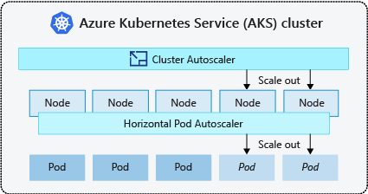
Cluster autoscaler

Slide 58
Cluster autoscaler
cluster autoscaler is typically used alongside the horizontal pod autoscaler.
When combined, the horizontal pod autoscaler increases or decreases the number of pods based on application demand, and the cluster autoscaler adjusts the number of nodes to run more pods.

Slide 59
Scale out events
If a node doesn't have sufficient compute resources to run a requested pod, that pod can't progress through the scheduling process.
Pod can't start unless more compute resources are available within the node pool.
When the cluster autoscaler notices pods that can't be scheduled because of node pool resource constraints, the number of nodes within the node pool is increased to provide extra compute resources.
When the nodes are successfully deployed and available for use within the node pool, the pods are then scheduled to run on them.
If your application needs to scale rapidly, some pods may remain in a state waiting to be scheduled until more nodes deployed by the cluster autoscaler can accept the scheduled pods.
For applications that have high burst demands, you can scale with virtual nodes and Azure Container Instances.

Slide 60
Scale in events
The cluster autoscaler also monitors the pod scheduling status for nodes that haven't recently received new scheduling requests.
This scenario indicates the node pool has more compute resources than required, and the number of nodes can be decreased.
By default, nodes that pass a threshold for no longer being needed for 10 minutes is scheduled for deletion.
When this situation occurs, pods are scheduled to run on other nodes within the node pool, and the cluster autoscaler decreases the number of nodes.
Your applications may experience some disruption as pods are scheduled on different nodes when the cluster autoscaler decreases the number of nodes.
To minimize disruption, avoid applications that use a single pod instance.

Slide 61
Kubernetes Event-driven Autoscaling (KEDA)
(KEDA) is an open source component for event-driven autoscaling of workloads.
Scales workloads dynamically based on the number of events received.
KEDA extends Kubernetes with a custom resource definition (CRD), referred to as a ScaledObject, to describe how applications should be scaled in response to specific traffic.
KEDA scaling is useful in scenarios where workloads receive bursts of traffic or handle high volumes of data.
Different from Horizontal Pod Autoscaler, as KEDA is event-driven and scales based on the number of events, while HPA is metrics-driven based on the resource utilization (for example, CPU and memory).

Slide 62
KEDA
KEDA add-on makes it even easier by deploying a managed KEDA installation, providing you with a rich catalog of Azure KEDA scalers that you can scale your applications with on your Azure Kubernetes Services (AKS) cluster.
KEDA add-on for AKS doesn't currently support modifying the CPU requests or limits for the Metrics Server or Operator. Keep this limitation in mind when using the add-on.

Slide 63
Architecture
KEDA provides two main components:
KEDA operator allows end-users to scale workloads in/out from 0 to N instances with support for Kubernetes Deployments, Jobs, StatefulSets or any custom resource that defines/scale subresource.
Metrics server exposes external metrics to Horizontal Pod Autoscaler (HPA) in Kubernetes for autoscaling purposes such as messages in a Kafka topic, or number of events in an Azure event hub.
Due to upstream limitations, KEDA must be the only installed external metric adapter.

Slide 64
Installation of KEDA
KEDA can be added to your Azure Kubernetes Service (AKS) cluster by enabling the KEDA add-on using an ARM template or Azure CLI.
The KEDA add-on provides a fully supported installation of KEDA that is integrated with AKS.

Slide 65
Capabilities and features
KEDA provides the following capabilities and features:
Build sustainable and cost-efficient applications with scale-to-zero
Scale application workloads to meet demand using a rich catalog of Azure KEDA scalers
Autoscale applications with ScaledObjects, such as Deployments, StatefulSets or any custom resource that defines /scale subresource
Autoscale job-like workloads with ScaledJobs
Use production-grade security by decoupling autoscaling authentication from workloads
Bring-your-own external scaler to use tailor-made autoscaling decisions
Integrate with Microsoft Entra Workload ID for authentication

Slide 66
Add-on limitations
The KEDA AKS add-on has the following limitations:
KEDA's HTTP add-on (preview) to scale HTTP workloads isn't installed with the extension, but can be deployed separately.
KEDA's external scaler for Azure Cosmos DB to scale based on Azure Cosmos DB change feed isn't installed with the extension, but can be deployed separately.
Only one external metric server is allowed in the Kubernetes cluster. Because of that the KEDA add-on should be the only external metrics server inside the cluster.
Multiple KEDA installations aren't supported

Slide 67
Burst to Azure Container Instances (ACI)
To rapidly scale your AKS cluster, you can integrate with Azure Container Instances (ACI).
Kubernetes has built-in components to scale the replica and node count.
However, if your application needs to rapidly scale, the horizontal pod autoscaler may schedule more pods than can be provided by the existing compute resources in the node pool.
If configured, this scenario would then trigger the cluster autoscaler to deploy more nodes in the node pool, but it may take a few minutes for those nodes to successfully provision and allow the Kubernetes scheduler to run pods on them.

Slide 68
Burst to Azure Container Instances (ACI)
ACI lets you quickly deploy container instances without extra infrastructure overhead.
When you connect with AKS, ACI becomes a secured, logical extension of your AKS cluster.
Virtual nodes component, which is based on virtual Kubelet, is installed in your AKS cluster that presents ACI as a virtual Kubernetes node.
Kubernetes can then schedule pods that run as ACI instances through virtual nodes, not as pods on VM nodes directly in your AKS cluster.
Application requires no modifications to use virtual nodes.
Deployments can scale across AKS and ACI and with no delay as the cluster autoscaler deploys new nodes in your AKS cluster.
Virtual nodes are deployed to another subnet in the same virtual network as your AKS cluster.
This virtual network configuration secures the traffic between ACI and AKS.
Like an AKS cluster, an ACI instance is a secure, logical compute resource isolated from other users.

Slide 69
Best practices to build and manage applications on AKS
Cluster operator best practices
If you're a cluster operator, work with application owners and developers to understand their needs. Then, you can use the following best practices to configure your AKS clusters to fit your needs.
An important practice that you should include as part of your application development and deployment process is remembering to follow commonly used deployment and testing patterns.
Testing your application before deployment is an important step to ensure its quality, functionality, and compatibility with the target environment.
Can help you identify and fix any errors, bugs, or issues that might affect the performance, security, or usability of the application or underlying infrastructure.

Slide 70
Best practices to build and manage applications on AKS
Application autoscaling
Application autoscaling is useful when dealing with cost optimization or infrastructure limitations.
A well-configured autoscaler maintains high availability for your application while also minimizing costs.
Only pay for the resources required to maintain availability, regardless of the demand.
For example, if an existing node has space but not enough IPs in the subnet, it might be able to skip the creation of a new node and instead immediately start running the application on a new pod.

Slide 71
Best practices to build and manage applications on AKS
Horizontal Pod autoscaling
Implementing horizontal pod autoscaling is useful for applications with a steady and predictable resource demand.
HPA dynamically scales the number of pod replicas, which effectively distributes the load across multiple pods and nodes.
Most beneficial for applications that can be decomposed into smaller, independent components capable of running in parallel.
HPA provides resource utilization metrics by default. You can also integrate custom metrics or leverage tools like KEDA
These extensions allow the HPA to make scaling decisions based on multiple perspectives and criteria, providing a more holistic view of your application's performance.
Especially helpful for applications with varying complex scaling requirements.

Slide 72
Best practices to build and manage applications on AKS
Vertical Pod autoscaling
Implementing vertical pod autoscaling is useful for applications with fluctuating and unpredictable resource demands.
VPA allows you to fine-tune resource requests, including CPU and memory, for individual pods, enabling precise control over resource allocation.
This granularity minimizes resource waste and enhances the overall efficiency of cluster utilization.
VPA also streamlines application management by automating resource allocation, freeing up resources for critical tasks.

Slide 73
Best practices to build and manage applications on AKS
shouldn't use the VPA in conjunction with the HPA on the same CPU or memory metrics.
This combination can lead to conflicts, as both autoscalers attempt to respond to changes in demand using the same metrics.
However, you can use the VPA for CPU or memory in conjunction with the HPA for custom metrics to prevent overlap and ensure that each autoscaler focuses on distinct aspects of workload scaling.

Slide 74
Best practices to build and manage applications on AKS
Node scaling and efficiency
Carefully monitor resource utilization and scheduling policies to ensure nodes are being used efficiently.
Node scaling allows you to dynamically adjust the number of nodes in your cluster based on workload demands.
It's important to understand that adding more nodes to a cluster isn't always the best solution for improving performance.
To ensure optimal performance, you should carefully monitor resource utilization and scheduling policies to ensure nodes are being used efficiently.

Slide 75
Best practices to build and manage applications on AKS
Use dedicated system node pools
For scaling performance and reliability, we recommend using a dedicated system node pool.
With this configuration, the dedicated system node pool reserves space for critical system resources such as system OS daemons.
Your application workload can then run in a user node pool to increase the availability of allocatable resources for your application.
This configuration also helps mitigate the risk of resource competition between the system and application.

Slide 76
Introduction - What is Garbage Collection in AKS?
Definition: A set of mechanisms designed to automatically clean up unused or unneeded resources within an AKS cluster and associated cloud infrastructure.
Purpose:
Prevents resource leakage (disk space, API objects).
Improves cluster performance and stability.
Optimizes costs by removing unused cloud resources.
Multi-Level Operation: GC functions at:
Kubernetes Control Plane (API objects).
Individual Nodes (Kubelet).
Cloud Provider Level (Azure resources).

Slide 77
Key Garbage Collection Mechanisms - Overview
Kubernetes Object Garbage Collection:
Managed by the Kubernetes Controller Manager.
Cleans up Kubernetes API objects (Pods, ReplicaSets, etc.).
Kubelet Garbage Collection:
Operates on each AKS node.
Manages unused container images and dead containers.
Handles node-level resource pressure (e.g., disk eviction).
Cloud Resource Garbage Collection (Indirect):
Deletion of Azure resources (Load Balancers, Disks) tied to Kubernetes objects.
Managed by AKS integration with Azure (Cloud Controller Manager).

Slide 78
Kubernetes Object GC - Details (Controller Manager)
Owner References & Cascading Deletion:
Core mechanism: Higher-level objects (e.g., Deployment) "own" lower-level ones (ReplicaSet, Pods).
Deleting an owner automatically deletes its dependents.
Best Practice: Use controllers like Deployments, StatefulSets, Jobs.
Finalizers:
Special keys on objects that block deletion until specific cleanup logic is executed by controllers.
Ensures orderly teardown (e.g., detaching a cloud disk before PV deletion).
TTL Controller for Finished Resources:
Jobs: spec.ttlSecondsAfterFinished field allows automatic cleanup of completed Jobs (and their Pods) after a set duration.
Pods: Similar TTL mechanism for orphaned Pods (Succeeded/Failed state, no owner) is often enabled via the TTLAfterFinished feature gate.

Slide 79
Kubernetes Object GC - Details (Controller Manager)
Owner References & Cascading Deletion: This is the primary mechanism.
When you create an object (e.g., a Pod through a Deployment), the Deployment becomes the "owner" of the ReplicaSet it creates, and the ReplicaSet becomes the "owner" of the Pods it creates.
If you delete the Deployment, Kubernetes automatically deletes the dependent ReplicaSets and Pods.
This is "cascading deletion."
Finalizers: These are special keys on objects that tell Kubernetes to wait for specific controllers to clean up resources before actually deleting the object.
For example, a PersistentVolume (PV) might have a finalizer that prevents its deletion until the associated cloud disk is detached and deleted.

Slide 80
Kubernetes Object GC - Details (Controller Manager)
TTL Controller for Finished Resources (Jobs & Pods):
Jobs: You can specify .spec.ttlSecondsAfterFinished in a Job manifest.
Once a Job completes (either successfully or failed), the TTL controller will clean up the Job (and its dependent Pods) after the specified duration.
Pods: A similar feature exists for Pods (alpha/beta stages in different K8s versions, often enabled by default in recent AKS).
Pods that reach a Succeeded or Failed phase and are not owned by a controller (like a Job or ReplicaSet) can be automatically cleaned up.
This is controlled by the TTLAfterFinished feature gate and the ttlSecondsAfterFinished field on the Pod spec (though less commonly set directly on Pods unless they are orphaned).

Slide 81
Kubelet GC - Details (Node-Level)
Managed by the Kubelet agent on each AKS node.
Unused Container Image Collection:
Periodically removes images not referenced by running or recently created Pods on the node.
Frees up node disk space.
Configurable via:
imageGCHighThresholdPercent (start GC if disk usage > X%)
imageGCLowThresholdPercent (stop GC if disk usage < Y%)
imageMinimumGCAge (minimum age of image to be GC'd)
Unused Container Collection:
Removes dead/exited containers.
Eviction Policies (Node Pressure):
Kubelet monitors node resources (disk, memory).
If thresholds (evictionHard, evictionSoft) are breached, Kubelet evicts Pods to reclaim resources.

Slide 82
Kubelet GC - Details (Node-Level)
The Kubelet running on each AKS node is responsible for:
Unused Container Image Collection: Kubelet periodically checks for container images that are no longer referenced by any running or recently created Pods on that node.
It removes them to free up disk space.
This is configured by imageGCHighThresholdPercent, imageGCLowThresholdPercent, and imageMinimumGCAge.
Unused Container Collection: Kubelet removes dead containers (those that have exited). This is usually very frequent.
Eviction Policies (Disk Pressure): Kubelet monitors node resources like disk space.
If disk usage exceeds certain thresholds (evictionHard, evictionSoft), Kubelet will start evicting Pods (and thereby cleaning up their containers and potentially images) to reclaim resources.

Slide 83
Cloud Resource GC - Details (Indirect)
AKS integrates with Azure to manage underlying cloud resources.
Examples:
Deleting a Kubernetes Service of type LoadBalancer triggers AKS to delete the associated Azure Load Balancer.
Deleting a PersistentVolumeClaim (PVC) that dynamically provisioned an Azure Disk can lead to the deletion of the PersistentVolume (PV) and the actual Azure Disk, based on the reclaimPolicy.
When you delete a Kubernetes Service of type LoadBalancer, AKS (via the cloud controller manager) will delete the associated Azure Load Balancer.
When you delete a PersistentVolumeClaim (PVC) that dynamically provisioned an Azure Disk, the associated PersistentVolume (PV) and the Azure Disk itself might be deleted or retained based on the reclaimPolicy of the StorageClass and PV.

Slide 84
Configuration Scope: Azure-Managed vs. User-Configurable
Azure-Managed (AKS Control Plane):
Global settings for Kubernetes Controller Manager.
API server feature gates (e.g., TTLAfterFinished for Pods typically enabled by default in modern AKS).
Users do not directly modify these.
User-Configurable:
Object Manifests:
Owner References (implicit in resource creation).
Job spec.ttlSecondsAfterFinished.
KubeletConfiguration (per Node Pool):
Image GC thresholds.
Node eviction policies.
StorageClass Definitions:
reclaimPolicy for dynamically provisioned storage.

Slide 85
What You Can Configure in AKS vs. What Azure Manages:
Azure Manages (Control Plane):
The Kubernetes Controller Manager (which handles owner references, finalizers, and the Job TTL controller) is part of the Azure-managed control plane. You don't directly configure its global parameters.
The API server feature gates (like TTLAfterFinished for Pods) are typically managed by Azure, though often enabled by default in modern AKS versions.
User Configurable (via manifests or KubeletConfiguration):
Owner References: You define these implicitly by how you create resources (e.g., a Deployment creating ReplicaSets/Pods).
Finalizers: Can be added to custom resources or observed on standard resources.
Job .spec.ttlSecondsAfterFinished: You set this directly in your Job manifests.
Kubelet Image GC & Eviction Policies: These can be customized per node pool using KubeletConfiguration in AKS.
StorageClass reclaimPolicy: You define this when creating a StorageClass.

Slide 86
Step-by-Step Guide to Configuring Garbage Collection Aspects in AKS:
Customize the node configuration for Azure Kubernetes Service (AKS) node pools - Azure Kubernetes Service | Microsoft Learn

Slide 87
Configuring Job TTL (Time-To-Live)
Purpose: Automatically clean up finished Jobs and their Pods.
Method: Set spec.ttlSecondsAfterFinished in the Job manifest.
Action: Apply the Job manifest using kubectl apply -f <job-file.yaml>.
Result: Job and its Pods are deleted after the specified TTL once the Job status is Complete or Failed.

Slide 88
Configuring Job TTL (Time-To-Live)
Example (Job YAML):
apiVersion: batch/v1
kind: Job
metadata:
name: pi-with-ttl
spec:
ttlSecondsAfterFinished: 120 # Deletes 120s after completion
template:
# ... Pod template ...

Slide 89
Configuring Kubelet Image GC (Node Pool Level)
Purpose: Customize how aggressively Kubelet reclaims disk space used by unused images.
Method: Via a KubeletConfiguration file applied to an AKS node pool.
Step 1: Create kubeletconfig.json:
{
"imageGCHighThresholdPercent": 80,
"imageGCLowThresholdPercent": 70,
"imageMinimumGCAge": "2m"
}

Slide 90
Configuring Kubelet Image GC (Node Pool Level)
Step 2: Apply to Node Pool (Azure CLI):
For a new node pool: az aks nodepool add --cluster-name <AKS_NAME> -g <RG_NAME> --name <POOL_NAME> --kubelet-config ./kubeletconfig.json
For an existing node pool: az aks nodepool update --cluster-name <AKS_NAME> -g <RG_NAME> --name <POOL_NAME> --kubelet-config ./kubeletconfig.json
Caution: Updating an existing node pool causes nodes to be re-imaged one by one. Plan for potential workload disruption.

Slide 91
Configuring Kubelet Eviction Policies (Node Pool Level)
Purpose: Define rules for Kubelet to evict Pods when node resources (disk, memory) are low.
Method: Via the same KubeletConfiguration file applied to an AKS node pool.
Step 1: Update/Create kubeletconfig.json:
Step 2: Apply to Node Pool (Azure CLI):
Use az aks nodepool add/update commands as shown for Image GC.
Caution: Node re-imaging applies.

Slide 92
kubeletconfig.json:
{
// ... image GC settings ...
"evictionHard": {
"memory.available": "100Mi",
"nodefs.available": "5%" // Evict if node root FS available < 5%
},
"evictionSoft": {
"memory.available": "200Mi",
"nodefs.available": "10%"
},
"evictionSoftGracePeriod": { // Grace period for soft limits
"nodefs.available": "1m30s"
}
}

Slide 93
Best Practices & Considerations
Monitoring is Key:
Utilize Azure Monitor for Containers to track node disk usage, memory, image counts, and eviction events.
Observe kubectl get events for GC-related activities.
Test Configuration Changes:
Apply Kubelet configurations in non-production environments first.
Understand the impact of node re-imaging on workloads. Use PodDisruptionBudgets.
AKS Defaults:
AKS often provides sensible defaults. Customize only when specific issues arise (e.g., frequent disk pressure).
Orphaned Resources:
Periodically scan for resources without owners (e.g., old ConfigMaps, Secrets, PVs with Retain policy).
Consider tools or scripts for cleanup.
Azure Policy:
Can be used to identify or remediate orphaned Azure resources not directly managed by Kubernetes GC.

Slide 94
Memory Management in AKS
Pod Memory Requests (spec.containers[].resources.requests.memory):
What it is: The amount of memory guaranteed to be available to a container.
Scheduling: The Kubernetes scheduler uses requests to find a node that has enough allocatable memory to accommodate the Pod. If a node doesn't have enough unallocated memory (sum of requests of existing Pods + new Pod's request <= node allocatable memory), the Pod won't be scheduled there.
Not a Limit: A container can use more memory than its request, up to its limit (or up to node capacity if no limit is set).
QoS Class: Contributes to the Pod's Quality of Service (QoS) class.

Slide 95
Memory Management in AKS
Pod Memory Limits (spec.containers[].resources.limits.memory):
What it is: The maximum amount of memory a container is allowed to consume.
Enforcement: If a container tries to exceed its memory limit, it will be terminated by the runtime (OOMKilled - Out Of Memory Killed).
QoS Class: Also contributes to the Pod's QoS class.

Slide 96
Memory Management in AKS
Quality of Service (QoS) Classes: Kubernetes categorizes Pods based on their requests and limits:
Guaranteed:
Every container in the Pod has a memory limit and a memory request.
For every container, the memory limit is equal to the memory request.
These Pods are considered the highest priority and are least likely to be killed if the node runs out of memory (after BestEffort and Burstable).

Slide 97
Memory Management in AKS
Quality of Service (QoS) Classes: Kubernetes categorizes Pods based on their requests and limits:
Burstable:
At least one container in the Pod has a memory request but its limit might be higher, or some containers might have requests/limits while others don't (but not all are BestEffort).
These Pods can use more memory than requested (burst) up to their limits.
If the node is under memory pressure, these Pods are killed after BestEffort Pods.

Slide 98
Memory Management in AKS
Quality of Service (QoS) Classes: Kubernetes categorizes Pods based on their requests and limits:
BestEffort:
No containers in the Pod have memory requests or limits specified.
These are the lowest priority and are the first to be killed if the node runs out of memory.
Generally discouraged for production workloads.

Slide 99
Memory Management in AKS
Node Allocatable Memory:
Not all memory on a node is available for Pods. Some is reserved for the OS, the Kubelet, and other system daemons.
Allocatable = Node Capacity - Kube-Reserved - System-Reserved - Eviction Thresholds
The sum of memory requests of all Pods on a node cannot exceed the node's allocatable memory.

Slide 100
Memory Management in AKS
Kubelet Eviction (memory.available):
The Kubelet on each node monitors available memory.
If memory.available drops below a configured threshold (e.g., evictionHard.memory.available: "100Mi"), the Kubelet will start evicting Pods (BestEffort first, then Burstable based on usage relative to requests) to reclaim memory.

Slide 101
Memory Management in AKS
Namespace ResourceQuotas & LimitRanges:
ResourceQuota: Sets aggregate memory request and limit totals for all Pods in a namespace.
LimitRange: Sets default memory request/limit values for containers in a namespace if not specified, and can also enforce min/max values.

Slide 102
Why Tune Memory Parameters?
Stability: Prevents Pods from consuming all node memory, leading to OOMKills or node instability (MemoryPressure condition).
Performance: Ensures critical applications have the memory they need. Prevents noisy neighbors from impacting performance.
Cost Optimization:
Avoids over-provisioning nodes by accurately requesting memory.
Allows for better "bin packing" of Pods onto nodes, potentially reducing the number of nodes needed.
Predictability: Makes resource consumption more predictable and manageable.

Slide 103
Step by step guide on Tuning Memory Parameters in AKS.

Slide 104
Best Practices for Memory Tuning:
Always set memory requests for production workloads. This is crucial for scheduling and stability.
Set memory limits to prevent runaway processes.
Start with requests = limits (Guaranteed QoS) for critical stateful applications. This provides the most stability.
Use Burstable QoS for applications that can tolerate occasional restarts and have variable load.
Avoid BestEffort QoS in production.
Monitor Continuously: Application memory profiles change. Regularly review usage.
Right-size your Nodes: Choose AKS VM SKUs that match your typical Pod memory footprints. Don't use overly large nodes if most pods are small, and vice-versa.
Consider Horizontal Pod Autoscaler (HPA): HPA can scale deployments based on custom metrics, including memory usage (though CPU is more common). If memory usage scales with load, HPA can help manage it by adding/removing Pods.
Profile Application-Level Memory: Kubernetes memory limits are at the container level. Understanding what inside your application consumes memory (e.g., JVM heap, caches, number of worker threads) is key to optimizing the application itself.
Iterate: Tuning is an ongoing process. Start with good estimates, monitor, and adjust.

Slide 105
Create a new AKS cluster with Cluster Autoscaler enabled
az aks create \
--resource-group myResourceGroup \
--name myAKSCluster \
--node-count 1 \
--vm-set-type VirtualMachineScaleSets \
--load-balancer-sku standard \
--enable-cluster-autoscaler \
--min-count 1 \
--max-count 3 \
--generate-ssh-keys

Slide 106
Create a new AKS cluster with Cluster Autoscaler enabled for a node pool
Create a new AKS cluster with Cluster Autoscaler enabled az aks create \ --resource-group MyResourceGroup \ --name MyAKSCluster \ --node-count 3 \ --node-pool-name agentpool1 \ --enable-cluster-autoscaler \ --min-count 2 \ --max-count 10

Slide 107
Enable the cluster autoscaler on an existing cluster
az aks update \
--resource-group myResourceGroup \
--name myAKSCluster \
--enable-cluster-autoscaler \
--min-count 1 \
--max-count 3

Slide 108
Disable the cluster autoscaler on a cluster
az aks update \
--resource-group myResourceGroup \
--name myAKSCluster \
--disable-cluster-autoscaler
Nodes aren't removed when the cluster autoscaler is disabled.
Note: You can manually scale your cluster after disabling the cluster autoscaler using the az aks scale command

Slide 109
Update the cluster autoscaler settings
As your application demands change, you might need to adjust the cluster autoscaler node count to scale efficiently.
Change the node count using the az aks update command and update the cluster autoscaler using the --update-cluster-autoscaler parameter and specifying your updated node --min-count and --max-count.
az aks update \
--resource-group myResourceGroup \
--name myAKSCluster \
--update-cluster-autoscaler \
--min-count 1 \
--max-count 5

Slide 110
# Create a new AKS cluster with VPA enabled az aks create \ --resource-group MyResourceGroup \ --name MyAKSCluster \ --enable-vpa

Slide 111
# Create an HPA for a deployment kubectl autoscale deployment MyDeployment --min=2 --max=10 --cpu-percent=50

